Slide 1

Tiles and Non-Relational Models
Shreeraksha Achutha
Taranpreet Kaur
Madhuri Nagaraj Hebbale
Sindhuja Madabushi
Supervisor: Gabriel Campero
May 23rd, 2017

Slide 2
Structure
1. Team Roles
2. Topic Introduction
Data Models
Mapping from RDBMS to :
Key Value Stores
Key Value Column Stores
Graph based models (RDF/Property Graphs)
Initial implementation set up
3. Project Progress

Slide 3
Team Presentations – Roles (flexible roles)
Shreeraksha Achutha
Program: Data and Knowledge Engineering
Main tasks: prototypical implementation (Developer)
Taranpreet Kaur
Program: Digital Engineering
Main tasks: Literature research, paper presentation (Database Architect)
Madhuri Nagaraj Hebbale
Program: Data and Knowledge Engineering
Main tasks: Literature research, paper presentation (Manager)
Sindhuja Madabushi
Program: Data and Knowledge Engineering
Main tasks: Prototypical implementation (Developer)

Slide 4
Data Models
A data model is an abstract model that organizes elements of data and standardizes how they relate to one another and to properties of the real world entities.
[https://www.oercommons.org/authoring/14614-rdbms/3/view]

Slide 5
Key Value Store Models
A key-value store is a simple hash table, primarily used when all access to the database is via primary key.
The client can either
get the value for the key
put a value for a key
delete a key
How to Construct a Key ?
Define meaningful names(entity, attributes).
Entity Name + ':' + Entity Identifier +':' +Entity Attribute
Eg :Cust:7348:Age

Slide 6
Mapping of RDBMS to Key Value Stores
USERS
ID | NAME | LAST NAME | ADDRESS ID
1 | Sherlock | Holmes | 1
2 | John H. | Watson | 1
3 | Theresa | May | 2
ADDRESS
ID | STREET AND NUMBER | CITY | FLOOR
1 | 221b Baker St | London | 1st floor
2 | 10 Downing Street | London | NULL

Slide 7
Mapping of RDBMS to Key Value Stores
Key | Value
user/Sherlock | {“Name”: “Sherlock”, “Last Name”: “Holmes”, “Address”:”address/Baker221b ”}
user/Watson | {“Name”: “John H.”, “Last Name”: “Watson”, “Address”:”address/Baker221b ”}
user/Theresa1 | {“Name”: “Theresa”, “Last Name”: “May”, “Address”:”address/Downing10 ”}
address/Baker221b | {“StreetAndNumber”: “221b Baker St.”, “City”: “London”, “Floor”:”1st Floor”}
address/Downing10 | {“StreetAndNumber”: “10 Downing Street”, “City”: “London”}
The key is an index in the key-value store.
For a foreign key relation we can instruct the application to interpret values as Keys. eg: “user/Sherlock” = {“Name”: “Sherlock”, “Last Name”: “Holmes”, “Address”:”address/Baker221b ”}

Slide 8
Key Value Column Stores /Extensible Record stores
NAME COLUMN FAMILY
NAME | LAST NAME
{“Name”: “Sherlock”} | {“Last Name”: “Holmes”}
{“Name”: “John H.”} | {“Last Name”: “Watson”}
{“Name”: “Theresa”} | {“Last Name”: “May”}
ID
1
2
3
A table is a collection of column families.
Column Family - logical and physical grouping of columns
Row-Key is an implicit primary key to uniquely identify the record.
Every row in a table can have different set of columns identified by its row-key.

Slide 9
Mapping of RDBMS to Key Value Column Stores
Key Value Column Stores /Extensible Record stores
ADDRESS COLUMN FAMILY
STREETANDNUMBER | CITY | FLOOR
{“StreetAndNumber”: “221b Baker St.”} “Floor”: “1st Floor”} | {“City”: “London”}
{“StreetAndNumber”: “221b Baker St.”} “Floor”: “1st Floor”} | {“City”: “London”}
{“StreetAndNumber”: “10 Downing Street”} | {“City”: “London”} | {“Floor”:”1st Floor”}
ID
1
2
3

Slide 10
Data Representation Strategy - Key Value stores

Slide 11
Graph Database Management Systems(GDBMSs)
In GDBMSs data are stored as graphs and queries are expressed as traversal operations. This allows applications to scale to very large graph-based data sets.
In addition, since GDBMSs do not rely on a rigid schema, they provide a more flexible solution in scenarios where the organization of data evolves rapidly and dat is highly interconnected in nature like Semantic Web etc.
[https://goo.gl/images/sxJlGB]

Slide 12
Mapping of RDBMS to Property Graphs
USERS
ID | NAME | LAST NAME | ADDRESS ID
1 | Sherlock | Holmes | 1
2 | John H. | Watson | 1
3 | Theresa | May | 2
ADDRESS
ID | STREET AND NUMBER | CITY | FLOOR
1 | 221b Baker St | London | 1st floor
2 | 10 Downing Street | London | NULL

Slide 13
Mapping of RDBMS to Property Graphs
For each row that has no many to many relations: create a vertex and make all the columns that are not a foreign key a vertex property.
For each one to many relations, create an edge between the 2 vertices and set all the remaining attributes as edge properties.
For each many to many relation, create an edge and set all the remaining attributes as edge properties.

Slide 14
Mapping of RDBMS to Property Graph

Slide 15
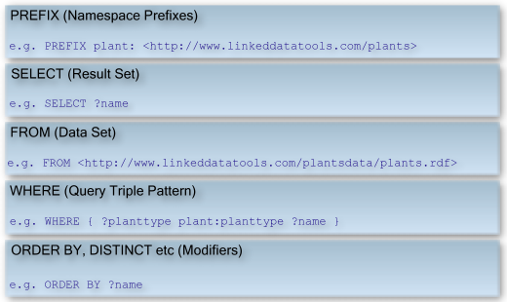
Mapping of RDBMS to RDF(Triplestore)
What does RDF stand for ???
Resource Description Framework - databases which store data in the format subject-predicate-object, which is known as a triple like "Bob is 35" or "Bob knows Fred”.
How do we retrieve data from RDF ???
Semantic queries - SPARQL

Slide 16
Mapping of RDBMS to RDF(Triplestore)

Slide 17
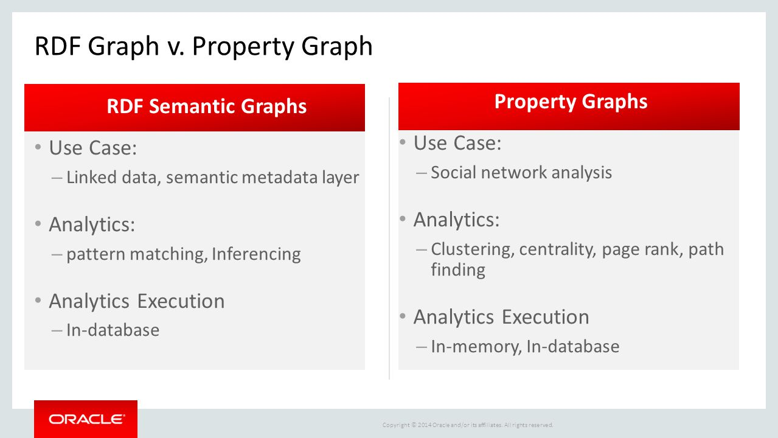
Property Graphs vs RDF
[https://goo.gl/images/OD3ONb]

Slide 18
Early Implementation Setup

Slide 20
Project Progress
Milestone | Date | Task Description
Milestone 1 | 12.04 – 02.05 | DONE – Initial Research, Presentation and Team Organization
Milestone 2 | 02.05 – 23.05 | DONE –Structure of the paper, introduction, Research on models and early implementation setup.
Milestone 3 | 23.05 – 13.06 | First draft of the paper, early results of the implementation
Milestone 4 | 13.06 – 04.07 | FINAL presentation with the results

Slide 21
Thank you!
Questions?

Slide 22
References

